Slide 1
CASPER @ IITB Effective Mimicry of Belady’s MIN Policy
HPCA 2022
Sumon
sumon@cse.iitb.ac.in

Slide 2
Outline
Proposed solution - Mockingjay
Why it works?
Evaluation
Conclusion
Notes:
ETA: Expected time of arrival

Slide 3
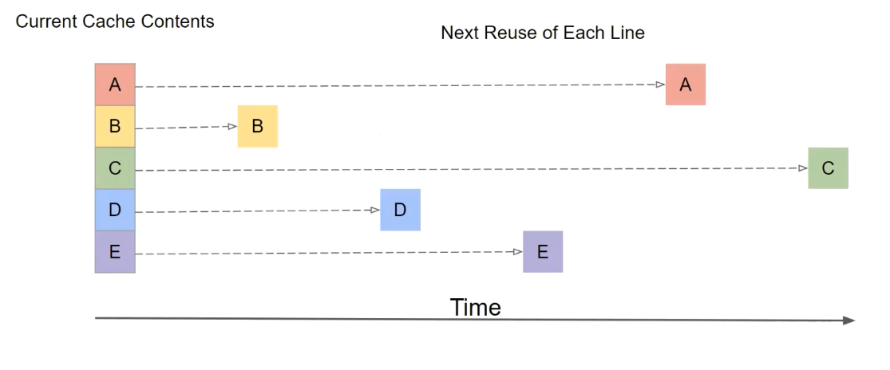
Belady’s MIN Policy

Slide 4
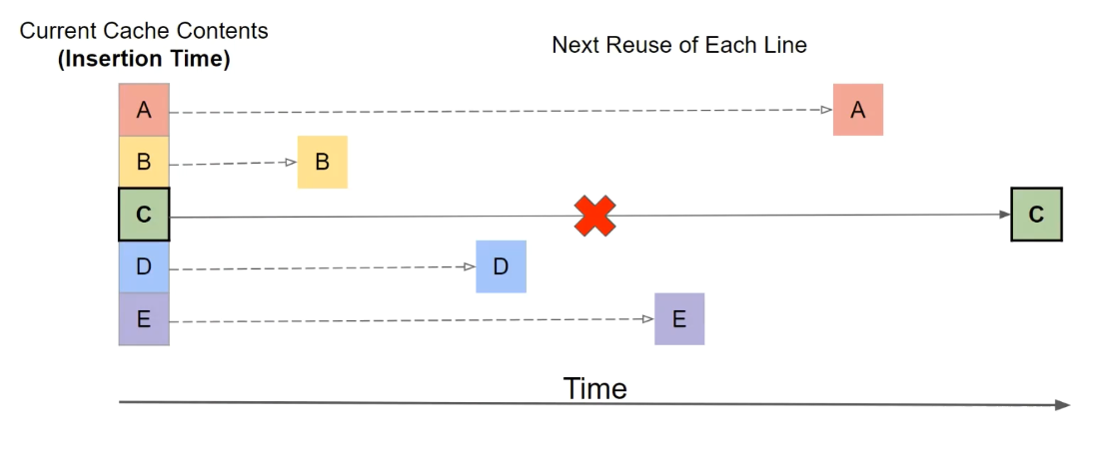
Belady’s MIN Policy

Slide 5
Proposed method: Mockingjay
Emulate Belday’s MIN policy
Predicts Estimated time of arrival(ETA)
Evicts cache line with highest ETA
Notes:
ETA: Expected time of arrival

Slide 6
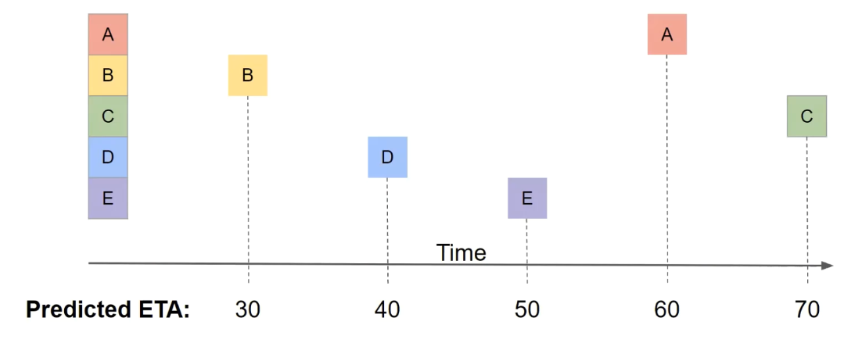
Mockingjay- example
Cache contents
Notes:
ETA: Expected time of arrival

Slide 7
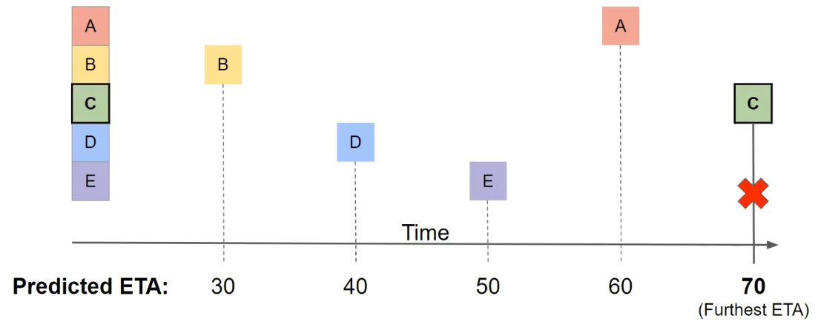
Mockingjay- example
Cache contents
(insertion time)
Notes:
ETA: Expected time of arrival

Slide 8
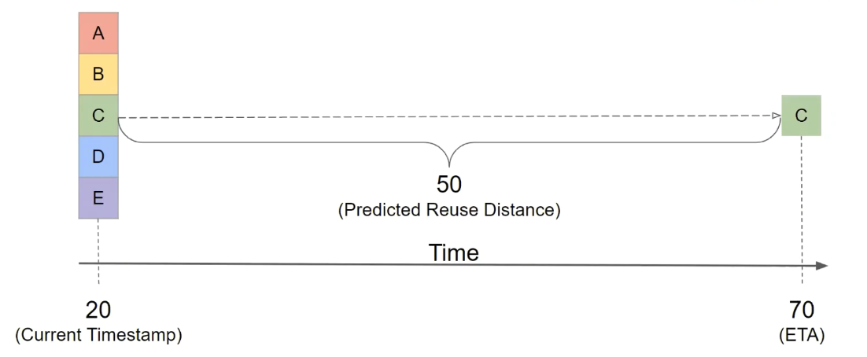
ETA computation
Cache contents
Predicted Reuse Distance
ETA = Current time + predicted reuse distance
Notes:
ETA: Expected time of arrival

Slide 9
Reuse distance prediction
PC signature
Line address
Reuse Distance Predictor
LLC
ETA counters
Predicted reuse distance
Stores reuse distance per PC
ETA per cache line
How does RDP learns reuse distances?

Slide 10
Training
Line address
Sampled Cache
Last Reuse distance
Reuse Distance Predictor
Last PC signature
Tracks the past reuse distance
Long history for few cache sets

Slide 11
Any Questions

Slide 12
Differentiating properties
Misprediction impact
Relative ordering of eviction
Delayed interpretation of ETA

Slide 13
Under-predicted ETA
Add after every thing is done

Slide 14
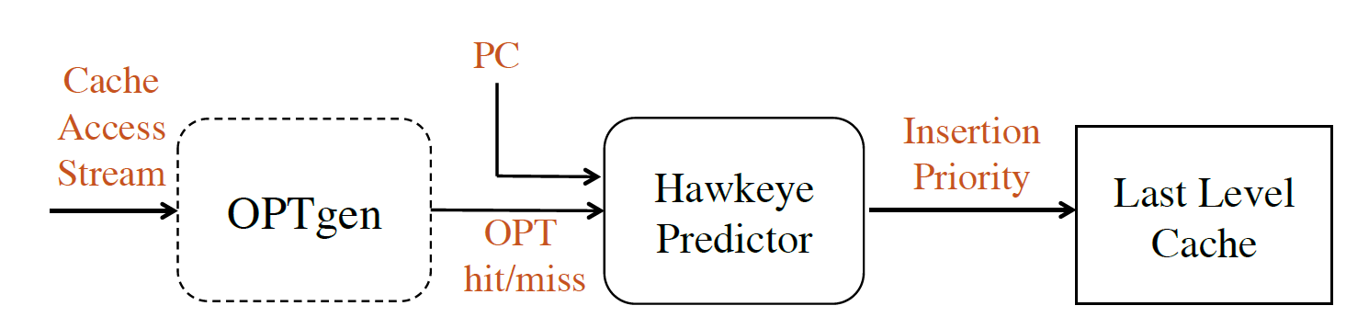
Prior work: Hawkeye
(Sampled Cache)
(RDP)
Cache friendly
Prediction
Cache averse
Binary classification

Slide 15
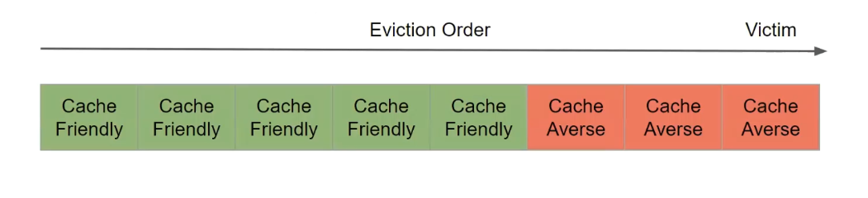
Binary classification problem

Slide 16
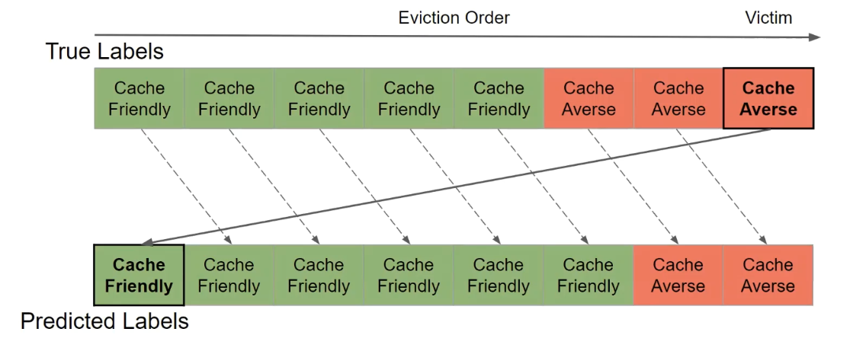
Binary classification problem
Misprediction -> global impact

Slide 17
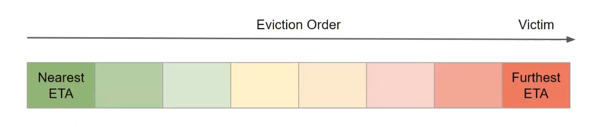
Mockingjay

Slide 18
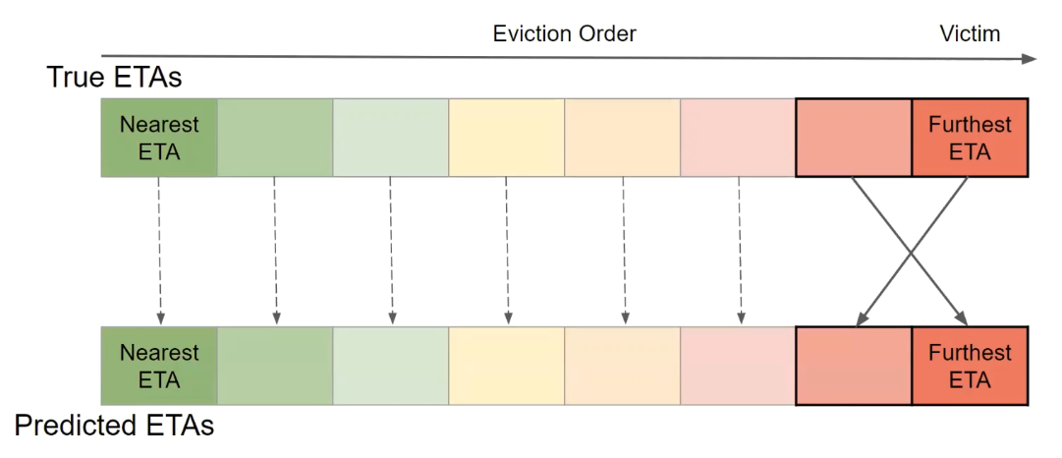
1. Mockingjay - misprediction
Misprediction -> local impact

Slide 19
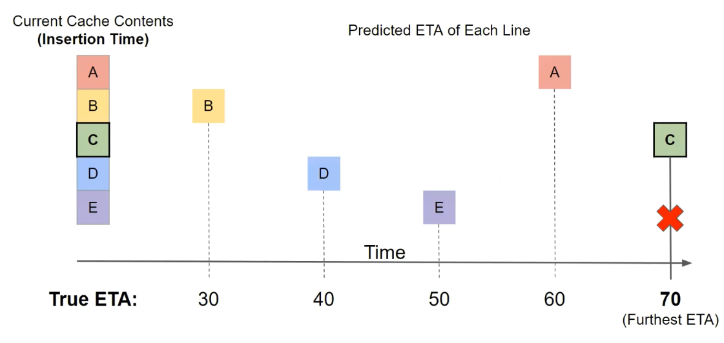
2. Relative eviction ordering

Slide 20
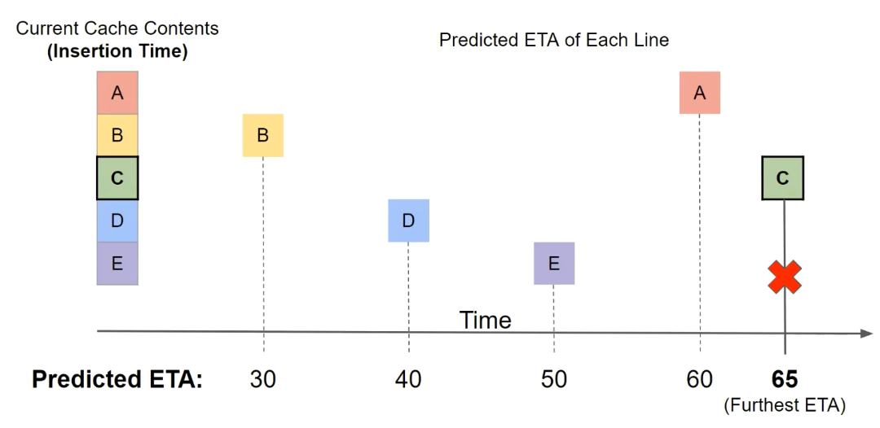
Misprediction - Mockingjay
Relative order is correct for mispredicted ETA

Slide 21
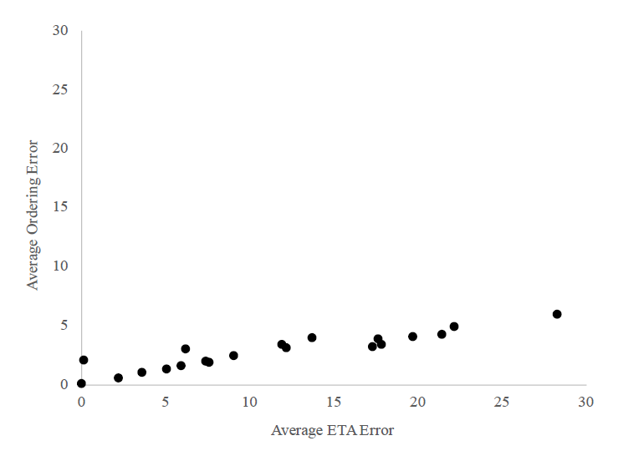
Relative ordering error
Ordering error on every misprediction
Low ordering error, even with high misprediction

Slide 22
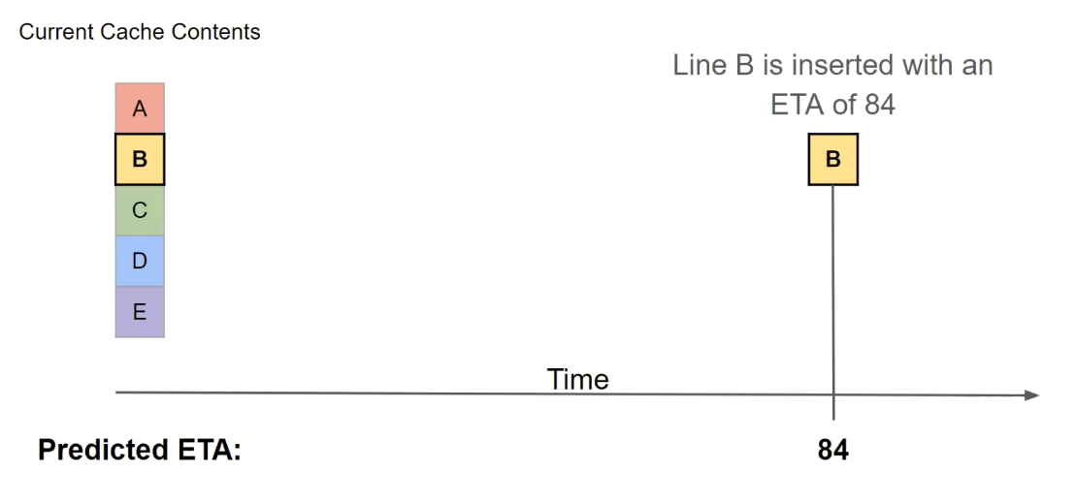
3. Delayed interpretation of ETA
Eviction priority interpreted at eviction time instead of insertion time

Slide 23
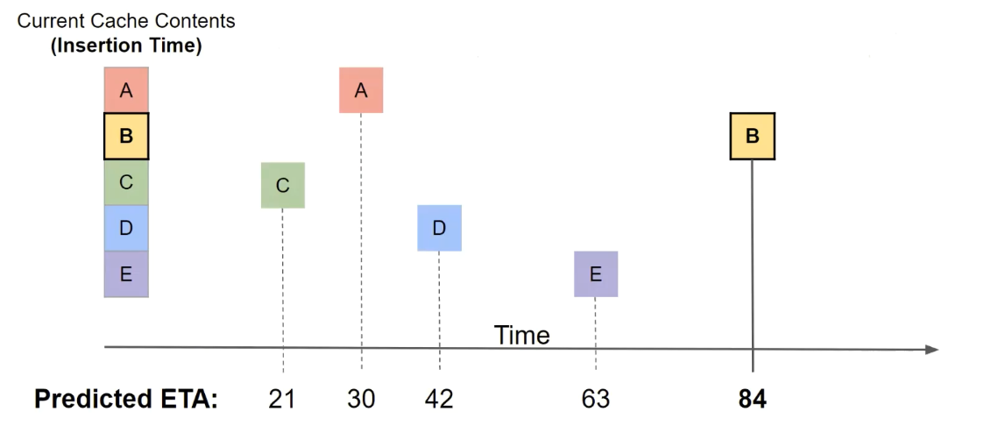
Scenario 1

Slide 24
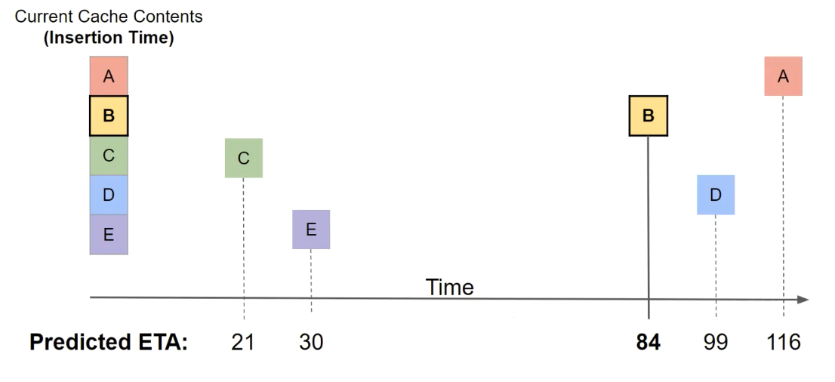
Scenario 2
Eviction order depends on ETA of all cache lines

Slide 25
Evalution Methodology
Simulator: Champsim
33 memory-sensitive workloads from SPEC CPU2006, SPEC CPU2017 and GAP
Prefetcher used: IP-stride
Multicore
Number of cores: 4
100 mixes from the 33 workloads

Slide 26
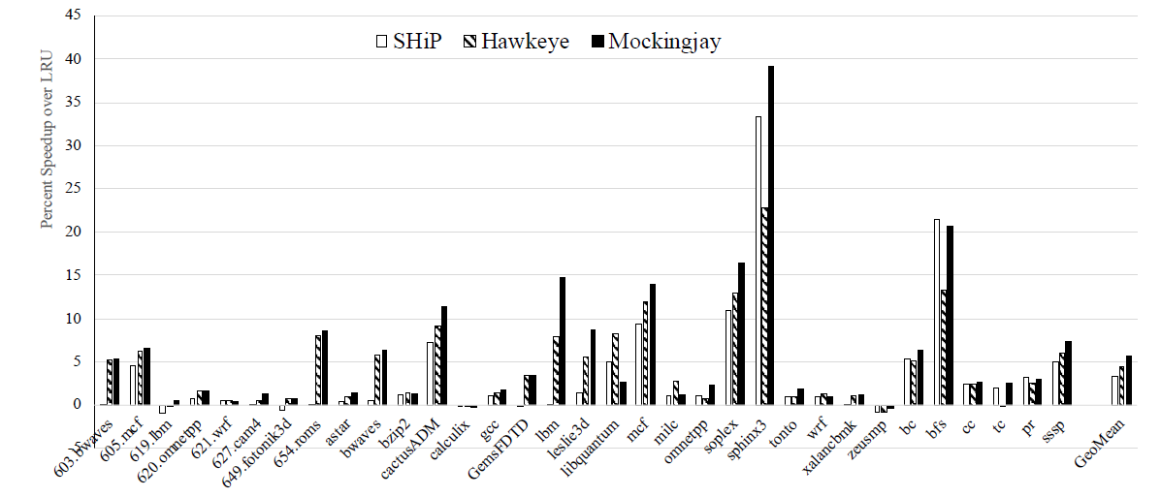
Speedup: single-core, no prefetching
Speedup of 5.5% over LRU close to 6% of MIN

Slide 27
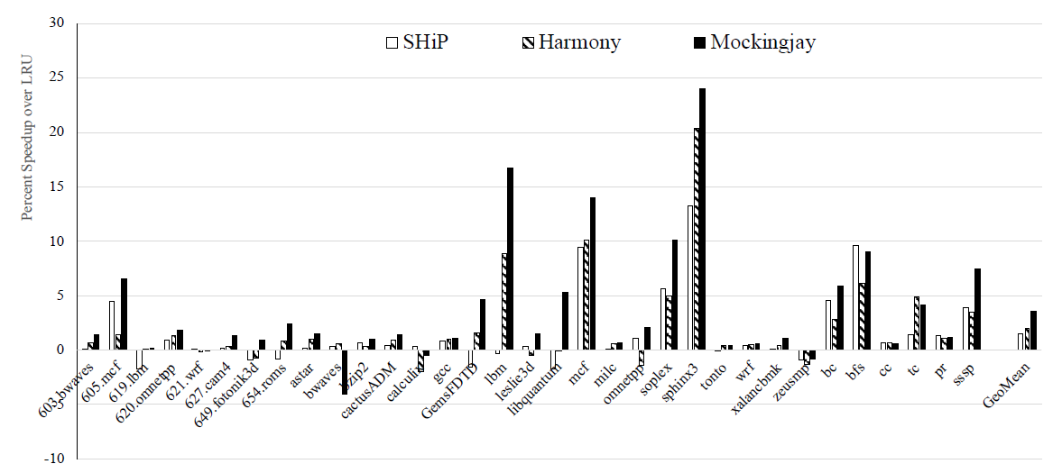
Speedup: single-core, with prefetching
Speedup of 3.6% over LRU compared to 2% with Harmony

Slide 28
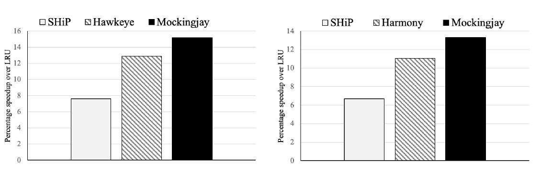
Speedup: 4-core
No prefetching
With prefetching
No prefetching: 15.2%, with prefetching: 13.3%

Slide 29
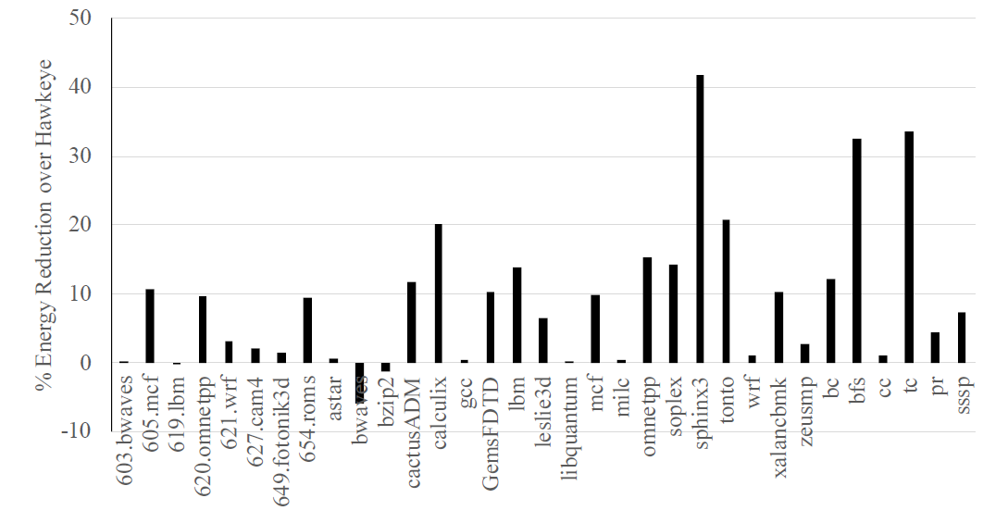
Energy reduction
Reduces energy consumption by 9.1% compared to Hawkeye.

Slide 30
Conclusion
Mockingjay mimics Belady’s MIN policy
Uses a ETA based approach instead of binary classification
Achieves performance close to MIN policy

Slide 31
Acknowlegements
Some of the figures are taken from this paper and from the slides of Ishan Shah

Slide 32
Thank You

